Slide 1
PSNA COLLEGE OF ENGINEERING AND TECHNOLOGY,
(An Autonomous Institution Affiliated to Anna University, Chennai)
DINDIGUL-624622
DESIGN OF 6G EDGE FED 2X2 ARRAY ANTENNA USING FR4 SUBSTRATE
Batch Members
Guided by
921320106010 - Ajith Selvakumar K Mr. K. Ramamoorthy. M.Tech,
921320106012 – Akilan S Associate Professor
921320106039- Easwaramoorthy Sriram Department of ECE, PSNACET
921320106050- Hasmath Ali A

Slide 2
ABSTRACT
This project delves into designing and simulating a dual-band 2x2 dual-array antenna targeting 6G communication systems.
The antenna leverages a cost-effective FR4 substrate for practical implementation. CST software serves as the design and performance evaluation platform.
The design focuses on achieving two distinct resonant frequencies within the 6G spectrum to accommodate the varied demands of future wireless technologies.
Key parameters like S parameter, VSWR, Phase, and Efficiency are meticulously analyzed using comprehensive CST simulations. The results are presented in detail, including relevant plots and discussions on potential trade-offs and considerations for real-world fabrication.
This work serves as a valuable resource for researchers and engineers interested in designing high-performance dual-band antenna arrays for 6G applications using FR4 substrates and CST software.
Keywords: Dual-Band Antenna, FR4 Substrate, CST Simulation, S-parameter, VSWR, Phase, Efficiency.

Slide 3
LITERATURE REVIEW
S/NO. | TITLE | ABSTRACT
1 | Design & Analysis of a Micro-strip Patch Antenna for RFID, WiMAX and X-band Applications. | The paper presents the design and simulation of a patch antenna resonating at 9.968 GHz, suitable for RFID, WiMAX, and X band applications.
2 | Design of 2x2 Wide Bandwidth MIMO Antenna for LTE and 5G Sub 6 GHz. | The Paper introduces the design of a 2x2 MIMO microstrip antenna for LTE and 5G Sub-6 GHz applications, with a wide bandwidth spanning 2300 MHz to 3600 MHz.
3 | Design and analysis of rectangular microstrip patch antenna at 2.4 and 5 GHz. | The Paper describes a study aimed at contributing to wireless communication and networking systems by proposing a rectangular microstrip patch antenna.
4 | Design and Implementation of Microstrip patch Antenna Arrays for 2.4 GHz Applications. | This paper focuses on designing and implementing microstrip antenna arrays for 2.4 GHz applications. It starts with a single element antenna and evaluates its performance in terms of operating frequency, return loss, gain, VSWR, and radiation patterns.

Slide 4
DRAWBACKS OF EXISTING SYSTEM
Limited Bandwidth
The existing design may suffer from limited bandwidth due to the inherent properties of FR4 substrate, which has relatively high dielectric loss and dispersion characteristics, especially at higher frequencies like 6G.
This limitation can lead to reduced performance and efficiency, particularly in terms of frequency coverage and data transmission rates.
Cross-Polarization and Side Lobes
The use of FR4 substrate in microstrip antennas can exacerbate issues related to cross-polarization and side lobes. Imperfections in the design or manufacturing process can result in higher cross-polarization levels and increased side lobes, impacting the antenna radiation pattern and overall performance.
Sensitivity to Environmental Factors
FR4 substrate antennas are often sensitive to environmental factors such as temperature variations and humidity.
Changes in environmental conditions can cause shifts in the dielectric properties of the substrate, leading to detuning of the antenna, impedance mismatches, and degradation of performance.
Manufacturing Tolerances and Cost
Achieving precise dimensions and tolerances in the manufacturing process of FR4-based antennas can be challenging and costly.
Variations in manufacturing can introduce inconsistencies among antennas, affecting their performance and reliability.

Slide 5
MERITS OF PROPOSED SYSTEM
Comprehensive Analysis
The methodology involves a comprehensive analysis of various parameters including Z-Matrix, VSWR, S-Parameter, directivity, far-field axial ratio, and efficiency. This thorough examination provides a holistic understanding of the antenna's performance.
Optimization
Through meticulous simulation and evaluation, the methodology aims to optimize the antenna's performance for next-generation wireless communication systems. Engineers can refine design parameters to achieve desired radiation patterns, coverage areas, and polarization performance.
Efficiency Assessment
The methodology evaluates the efficiency of the antenna, a critical aspect in antenna design, across different metrics. This allows engineers to understand how effectively the antenna converts input power into radiated power, enabling them to improve overall performance.
Polarization Analysis
By analyzing directivity patterns and far-field axial ratio, the methodology provides insights into the antenna's radiation characteristics and polarization properties. This facilitates the assessment of radiation intensity, beam shaping capabilities, and polarization diversity.

Slide 6
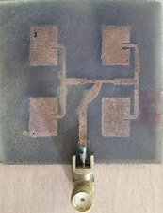
PROPOSED SYSTEM BLOCK DIAGRAM
Substrate | FR4(Lossy)
Frequencies fr | 5.8 and 6.02 GHz
Thermal Conductivity | 0.3 [W/K/m]
Substrate height, h | 1.6 mm
Dielectric Constant, εr | 4.6
Loss Tangent,δ | 0.025
Impedance, Zo | 50 Ω

Slide 7
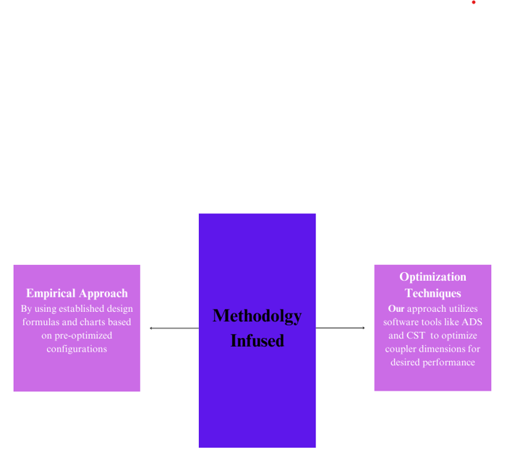
METHODOLOGY USED
Methodology Employed

Slide 8
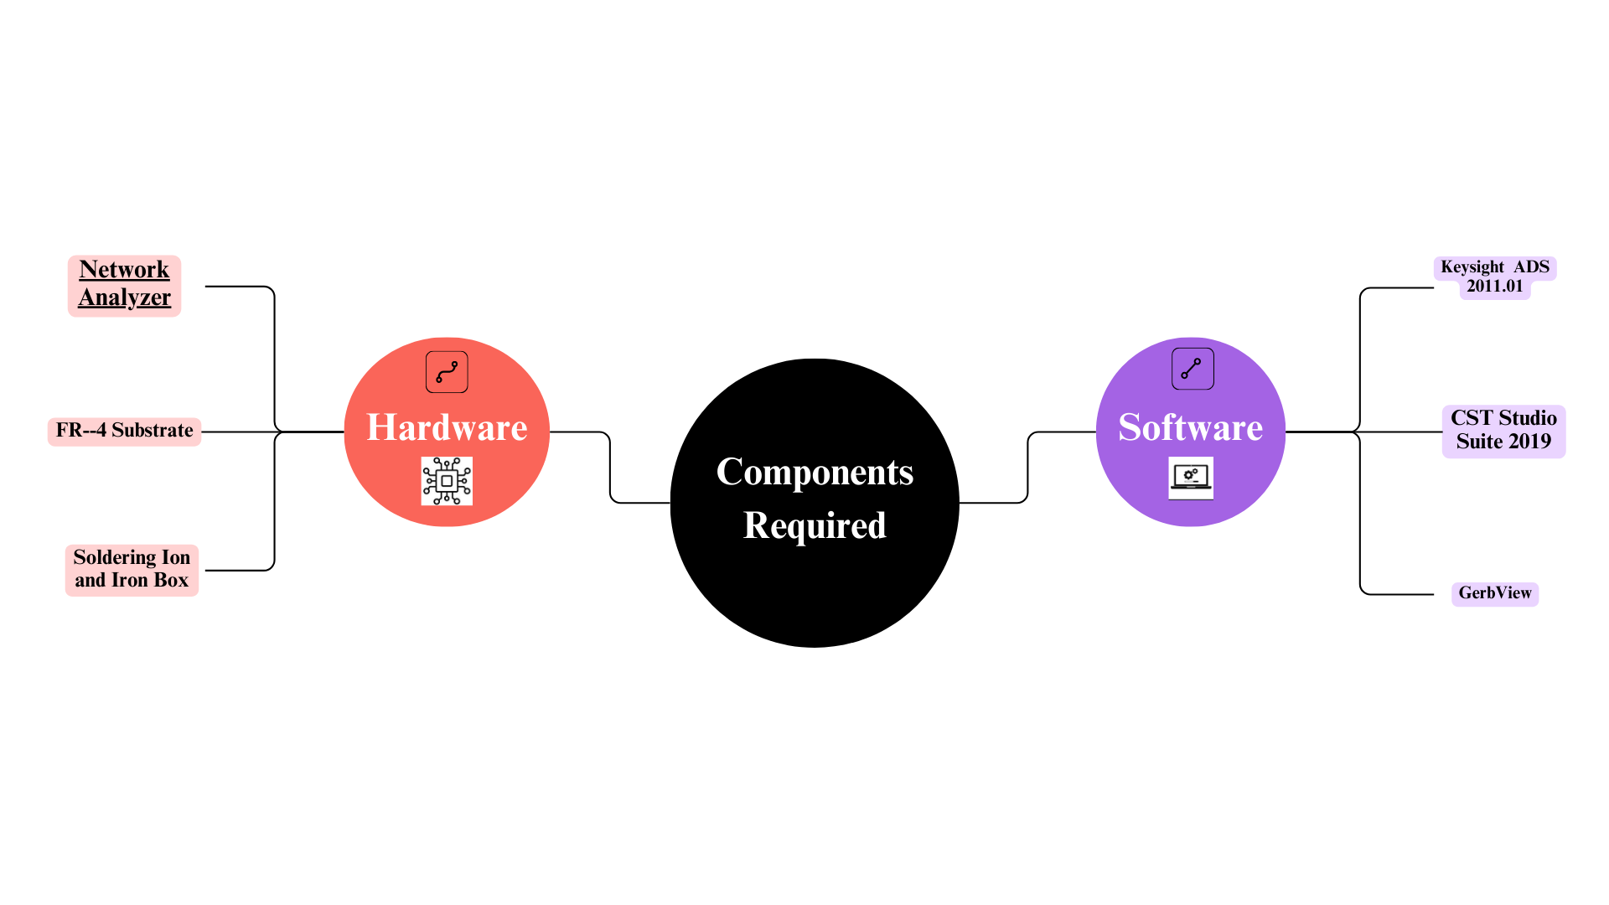
HARDWARE/SOFTWARE USED

Slide 9
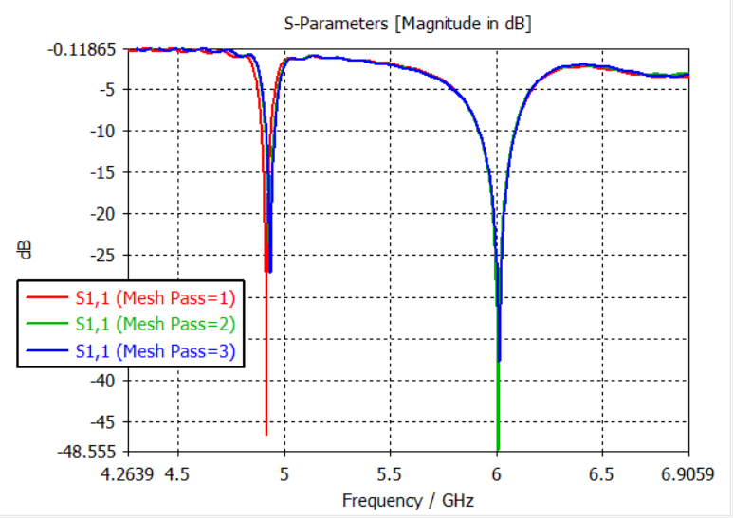
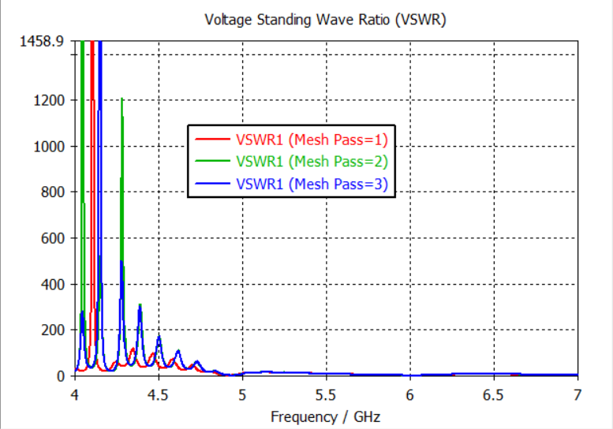
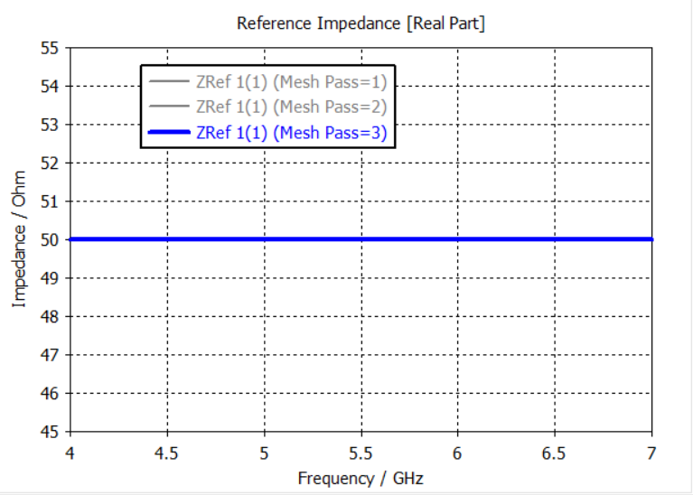
RESULTS OBTAINED(ONE DIMENSIONAL)
S-Parameter
VSWR
Note:
Here we enclosed some of the results of our project. So we disclosed the output under the topic of S-Parameter, VSWR, and Reference Impedance.
Reference Impedance

Slide 10
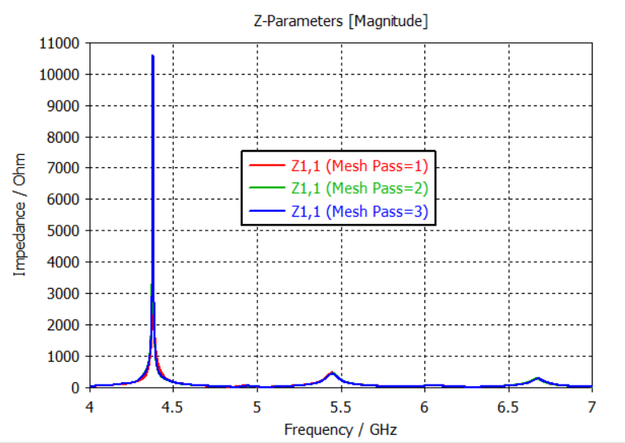
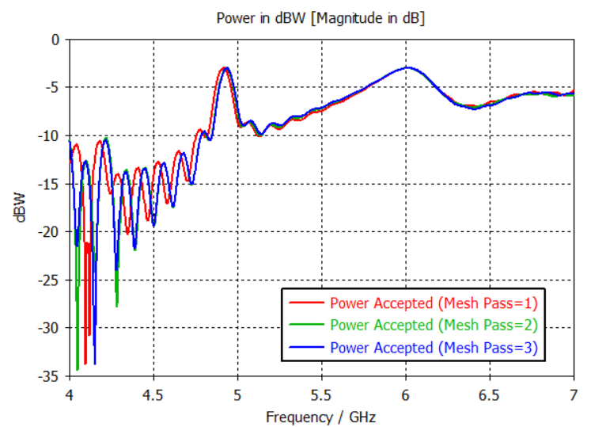
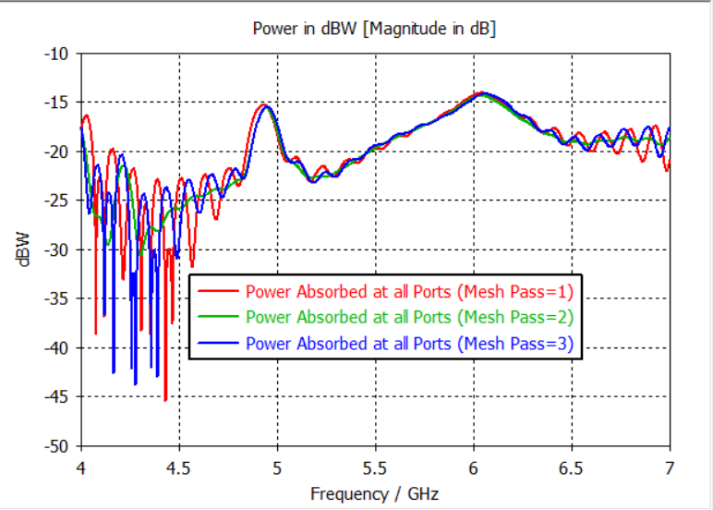
RESULTS OBTAINED
Z-Matrix
Power Accepted
Note:
In this slide we can see the Magnitude value of the Z-Matrix, Power accepted in all ports, and Power absorbed in all ports respectively.
Power Absorbed in all ports

Slide 11
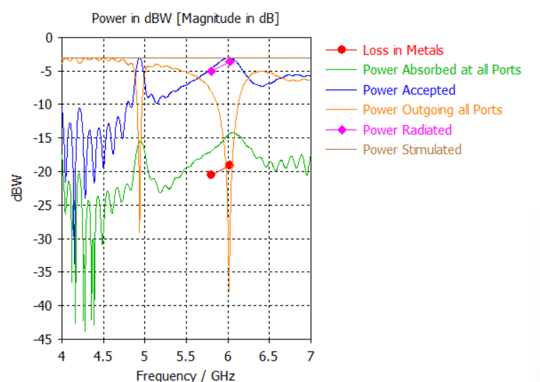
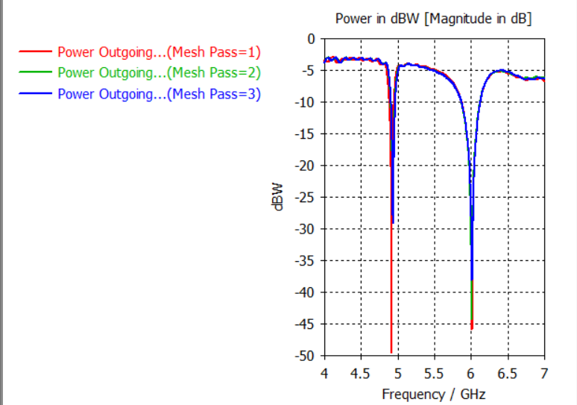
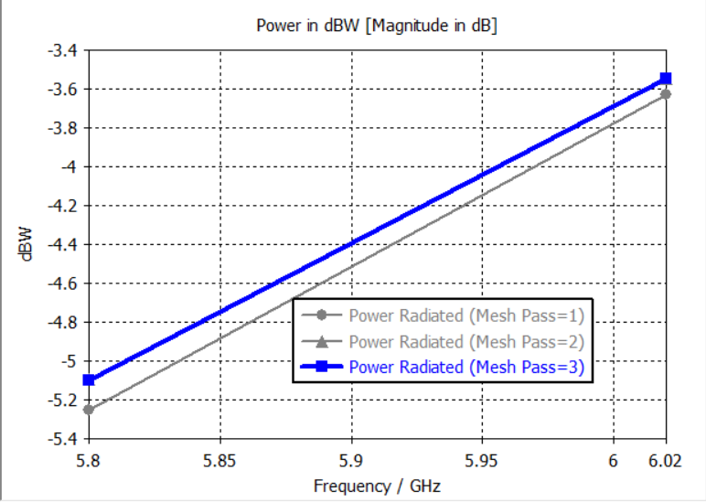
RESULTS OBTAINED
Excitation[1] Power
Power Outgoing all ports
Note:
Here we can see the Excitation power of an antenna, Power that gets radiated, and Effective power outgoing in all ports respectively.
Power Radiated

Slide 12
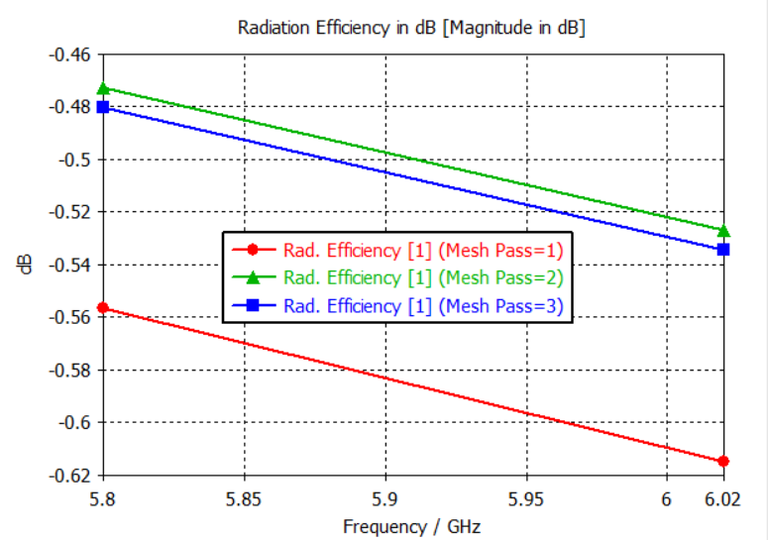
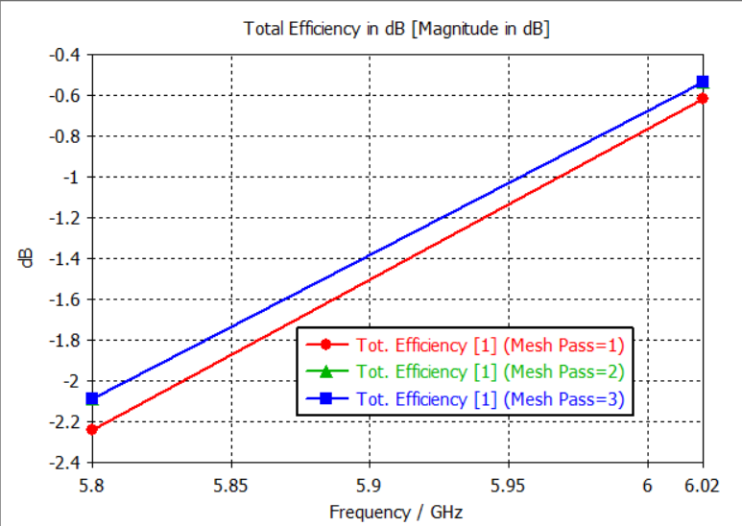
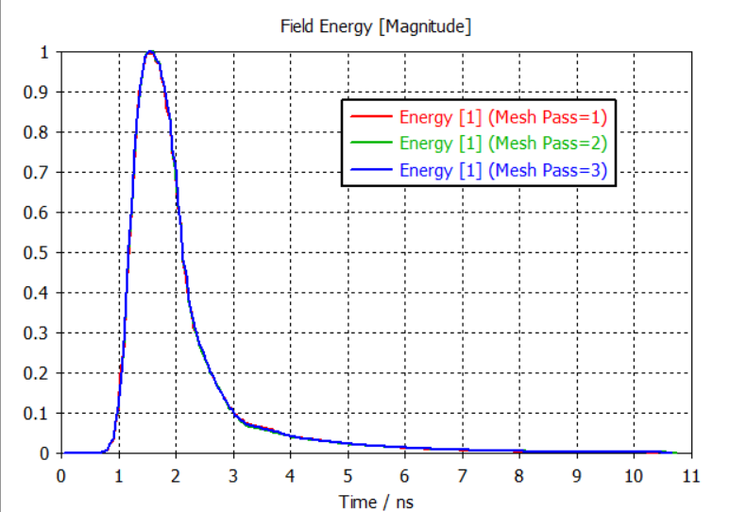
RESULTS OBTAINED
Radiation Efficiencies
Total Efficiency
Note:
Here attached the net Efficiency and Radiated power efficiency as well as the Field Energy with its mesh values
.
Field Energy with Messes values

Slide 13
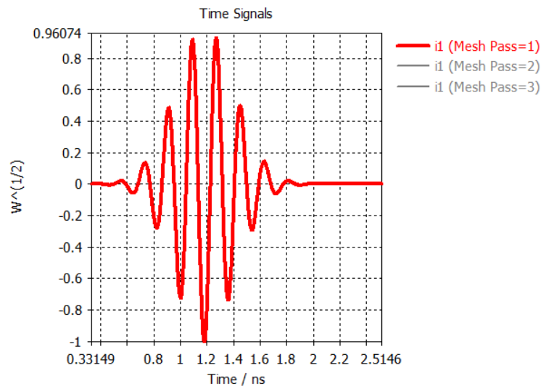
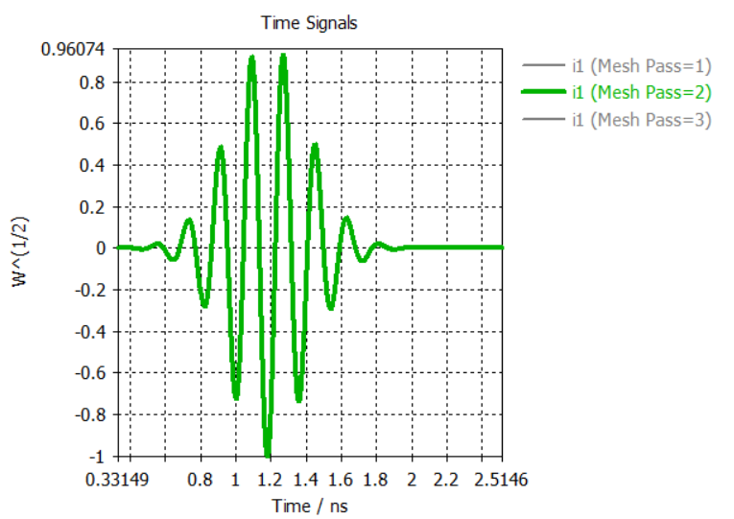
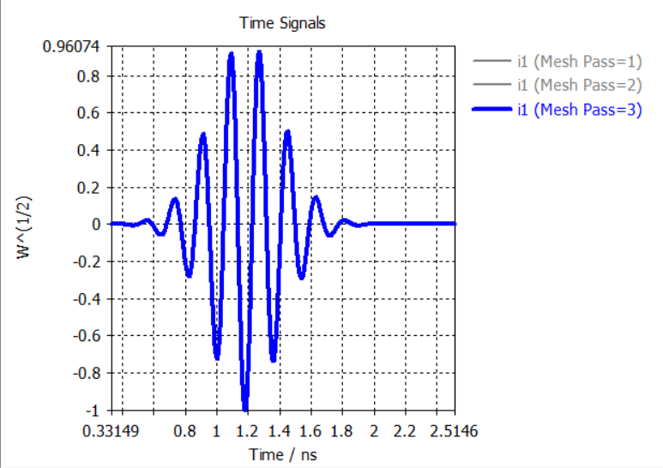
RESULTS OBTAINED
Port Signal(i1)@ Mesh pass1
Port Signal(i1)@ Mesh pass2
Note:
In this slide you can able to see the Port signals under variable mesh passes.
Port Signal(i1)@Mesh pass3

Slide 14
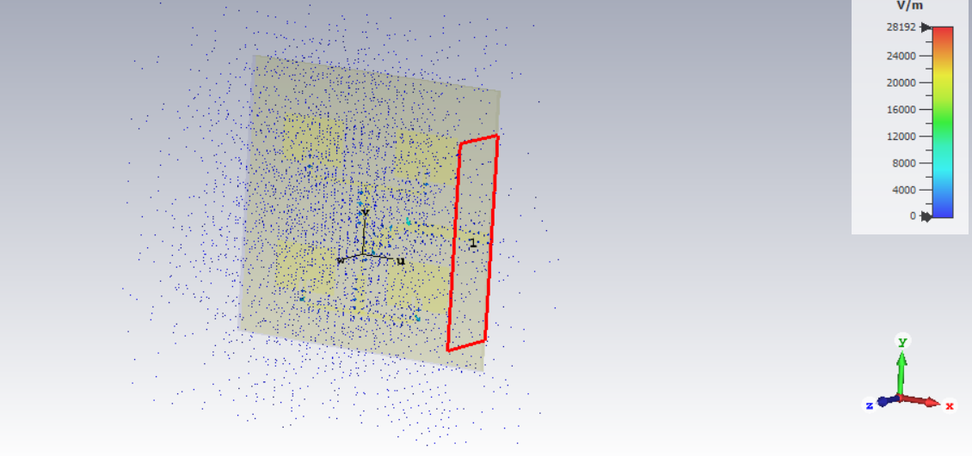
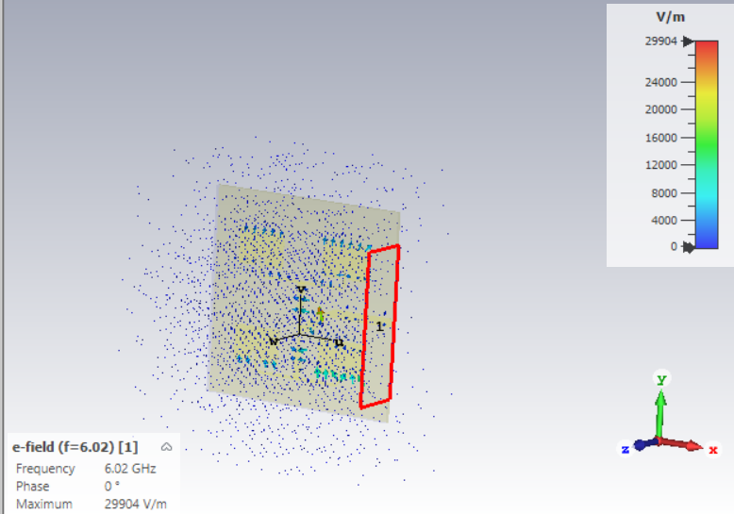
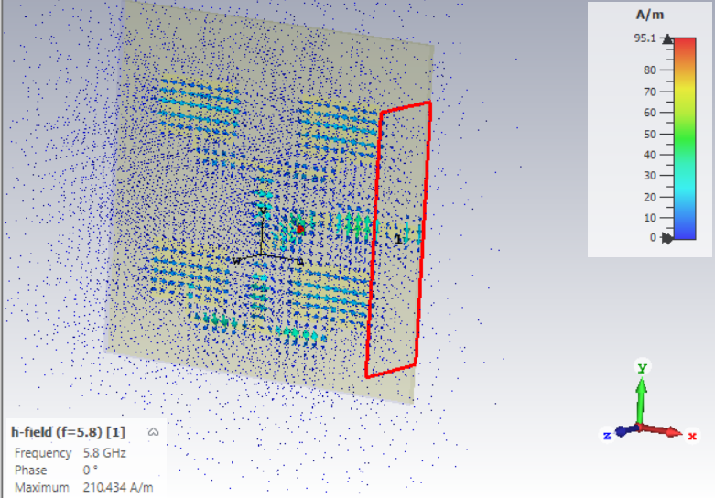
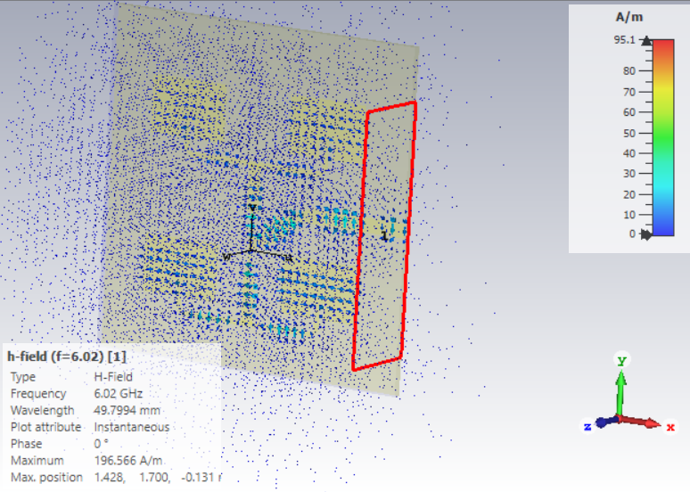
RESULTS OBTAINED(TWO DIMENSIONAL)
Note:
Here we enclosed some of the results of our project. So we disclosed the output under the topic of S-Parameter, VSWR, and Reference Impedance.
E-Field @ f=5.8 GHz
E-Field @ f=6.02 GHz
H-Field @ f=5.8 GHz H-Field @ f=6.02 GHz

Slide 15
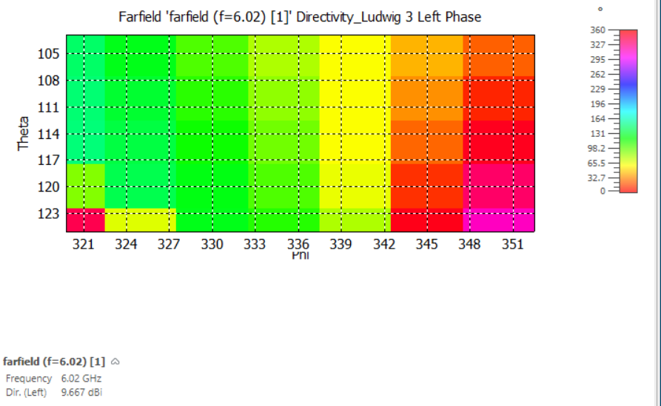
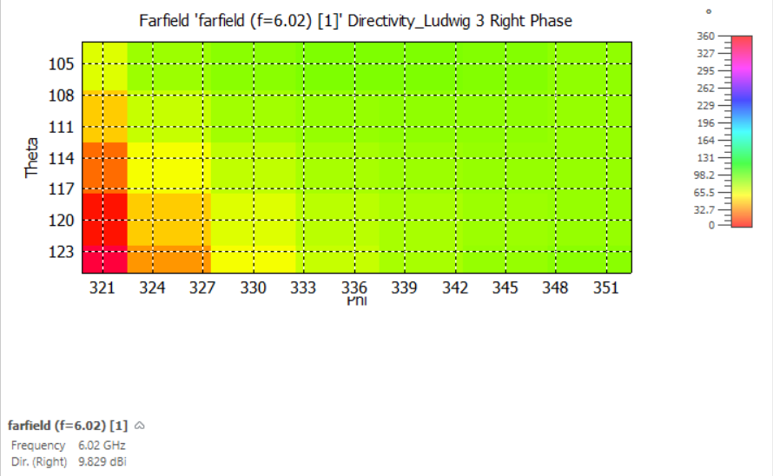
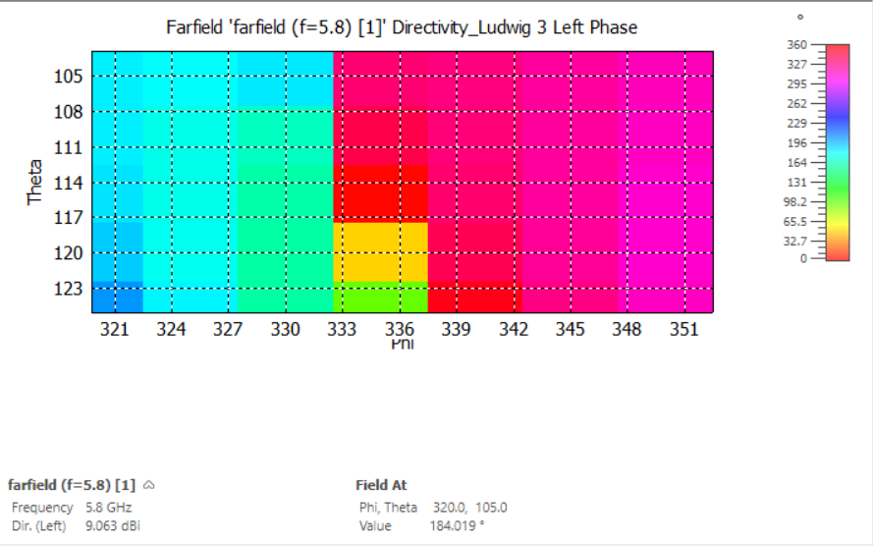
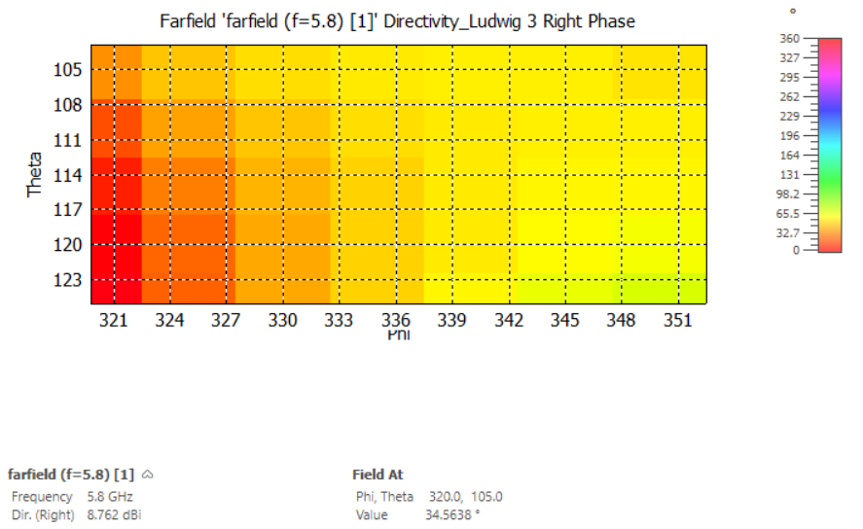
RESULTS OBTAINED(FARFIELD)
Farfield Directivity(left phase)@ f=6.02 GHz
Farfield Directivity(Right phase)@ f=6.02 GHz
Farfield Directivity(left phase)@ f=5.8 GHz Farfield Directivity(Right phase)@ f=5.8 GHz

Slide 16
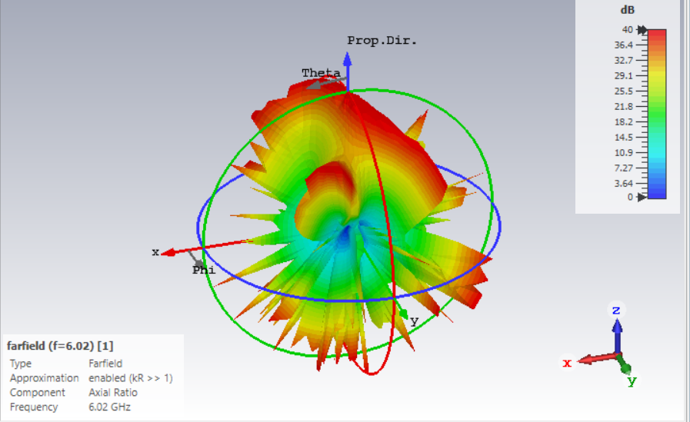
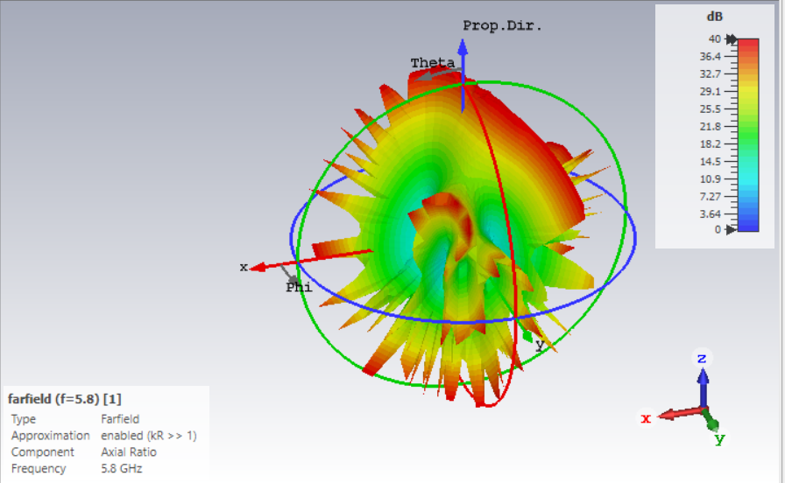
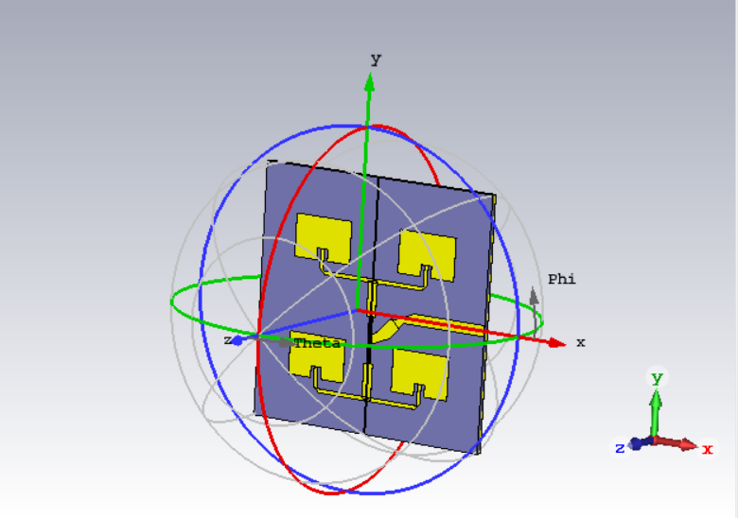
RESULTS OBTAINED
Farfield Axial ratio @ 6.02 GHz
Farfield Axial ratio @ 5.8 GHz
Note:
In this slide you can able to see the 3D representation of Farfield and its Axial ratio representation under 5.8 and 6.02 Ghz Frequencies.
Port Signal(i1)@Mesh pass3

Slide 17
APPLICATIONS
Telemedicine and Remote Healthcare:
Antennas designed with this methodology can facilitate high-speed and reliable communication in telemedicine systems, enabling remote consultations, medical diagnostics, and real-time monitoring of patients' health parameters.
Autonomous Vehicles:
Advanced antenna systems optimized using this methodology can support V2X communication in autonomous vehicles, enabling vehicle-to-vehicle (V2V), vehicle-to-infrastructure (V2I), and vehicle-to-pedestrian (V2P) communication for safer and more efficient transportation systems.
Smart Cities and Urban Infrastructure:
The methodology can be applied to design antennas for smart city applications, supporting IoT sensors, smart grids, intelligent transportation systems, and environmental monitoring networks, enhancing urban sustainability, efficiency, and quality of life.
Industry 4.0 and Smart Manufacturing:
Antennas designed using this methodology can enable wireless connectivity in smart factories and industrial automation systems, supporting real-time monitoring, control, and optimization of manufacturing processes for increased productivity and efficiency.
Augmented Reality (AR) and Virtual Reality (VR):
Advanced antenna systems can enhance the performance of AR and VR applications by enabling high-bandwidth, low-latency communication for immersive experiences, interactive gaming, virtual training

Slide 18
CONCLUSION
The design of the 6G edge Fed 2x2 array antenna using Fr4 substrate is a promising solution for various applications requiring high-frequency performance.
The analysis of the one-dimensional, two-dimensional, and far-field results collectively demonstrates the antenna's efficiency, directivity adjustability, and high-power levels, respectively.
Such investigations will require further refinement of the design and optimization to meet the specific needs of these applications. Additionally, the comparison of the efficiency at different energy-fed levels reveals that the antenna's efficiency decreases slightly as the energy-fed is reduced.
This highlights the importance of considering antenna efficiency in the design and optimization of the antenna for different applications. Overall, the design of the 6G edge Fed 2x2 array antenna using Fr4 substrate is a highly promising solution that can provide high-quality performance and lead to further advancements in the field of antenna technology

Slide 19
FUTURE WORK
Integration of Advanced Materials
Exploring the use of advanced materials with superior electrical properties, such as metamaterials or graphene, could enhance antenna performance, including bandwidth, efficiency, and radiation characteristics.
Optimization for Non-Ideal Environments
Further research can focus on optimizing antenna designs to operate effectively in non-ideal environments, such as urban areas with high levels of interference, indoor environments, or harsh outdoor conditions.
Miniaturization and Compact Design
Investigating techniques for miniaturization and compact design of antennas can enable integration into smaller devices and systems, such as wearable technology, IoT devices, and unmanned aerial vehicles (UAVs).
Multi-Band and Multi-Mode Operation
Designing antennas capable of operating across multiple frequency bands and supporting multi-mode communication can enhance versatility and compatibility with diverse communication standards and protocols.
Beamforming and MIMO Techniques
Implementing advanced beamforming and multiple-input multiple-output (MIMO) techniques can improve spectral efficiency, coverage, and reliability of communication systems, especially in dense urban environments and high-mobility scenarios.

Slide 20
REFERENCES
[1] “Design and Analysis of a Rectangular Microstrip Patch Antenna using Different Dielectric Materials for Sub-6GHz 5G Applications” S. Bala, Z. Yunusa, S. A. Babale Nigerian Journal of Engineering, Vol. 28, No. 2, August 2021.
[2] “Design and analysis of rectangular microstrip patch antenna at 2.4 and 5 GHz” Hamza Abbasi, Muhammad Nihal Naseer, Yasmin Abdul Wahab, Muhammad Mobin Siddiqi, Rozana Aina Maulat Osman, Nurul Ezaila Alias, and Hanim Hussin Conference Paper in AIP Conference Proceedings · July 2021.
[3] “Design of 2x2 Wide Bandwidth MIMO Antenna For LTE and 5GSub-6GHz” Rusdiyanto, D., Astuti, D. W., Muslim, Alam, S., & Adhiyoga, Y. G.JITE(2022).
[4] “Design of Microstrip Antenna Arrays with Rotated Elements Using Wilkinson Power Dividers for 5G Customer Premise Equipment Applications”. Ting-Yi Huang and Yun-Jhang Lee Hindawi International Journal of Antennas and Propagation Volume 2024, Article ID 2945195, 15 pages.
[5] “Design & Analysis of a Micro-strip Patch Antenna for RFID, WiMAX, and X-band Applications” Ms. Dilshad Jahan, Chinmoy Das, Nayan Sarker. 1st International Conference on Advances in Science, Engineering and Robotics Technology 2019 (ICASERT 2019).
[6] “Design and analysis of MIMO system for THz communication using terahertz patch antenna array based on photonic crystals with graphene”. Mohamed Elamine Benlakehal, Abdesselam Hocini, Djamel Khedrouche, Mohamed Nasr eddine Temmar, and Tayeb Ahmed Denidni.
[7] “Design and Implementation of Microstrip Patch Antenna Arrays for 2.4 GHz Applications” Gurudev, Dr. Mohammed Bakhar, this paper focuses on designing and implementing microstrip antenna arrays for 2.4 GHz applications.

Slide 21
THANK YOU ☺

